Slide 1
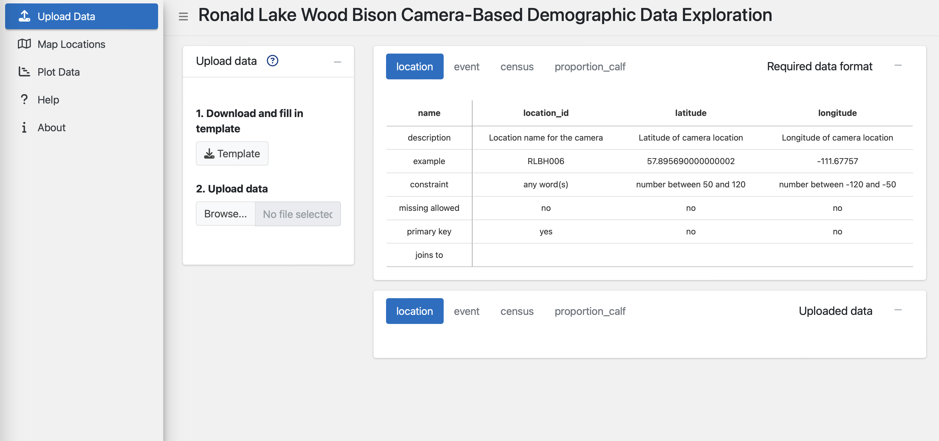
Button to expand or collapse tabs
Output of the actions and options
App tabs
Title of App
Instruction box, perform actions and select options
Button to access help information for the tab

Slide 2
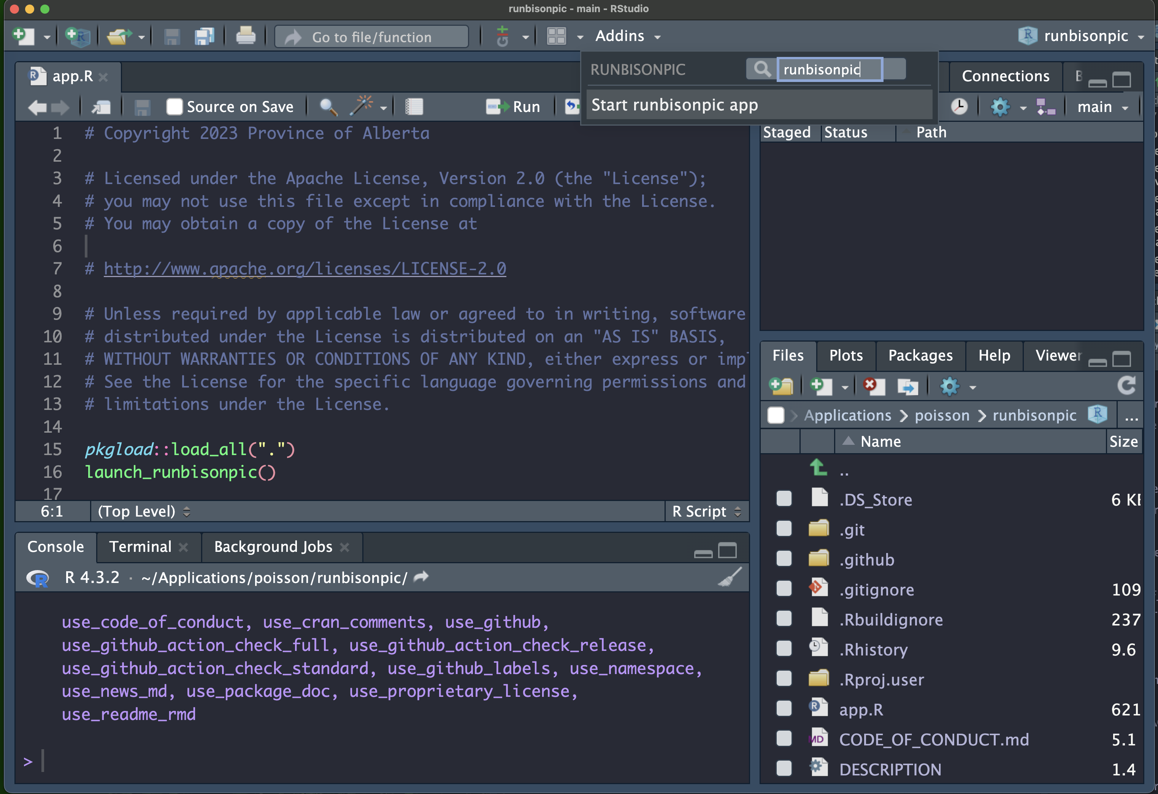

Slide 3
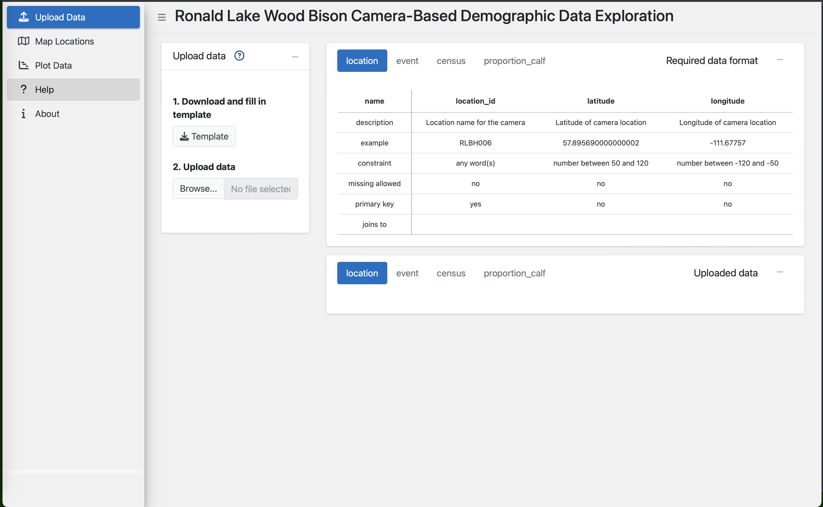
B
A
C
D

Slide 4
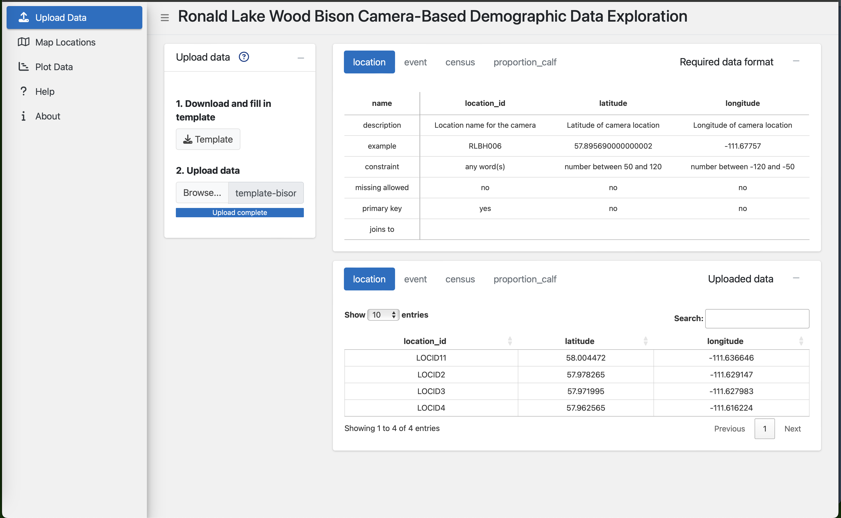
D

Slide 5
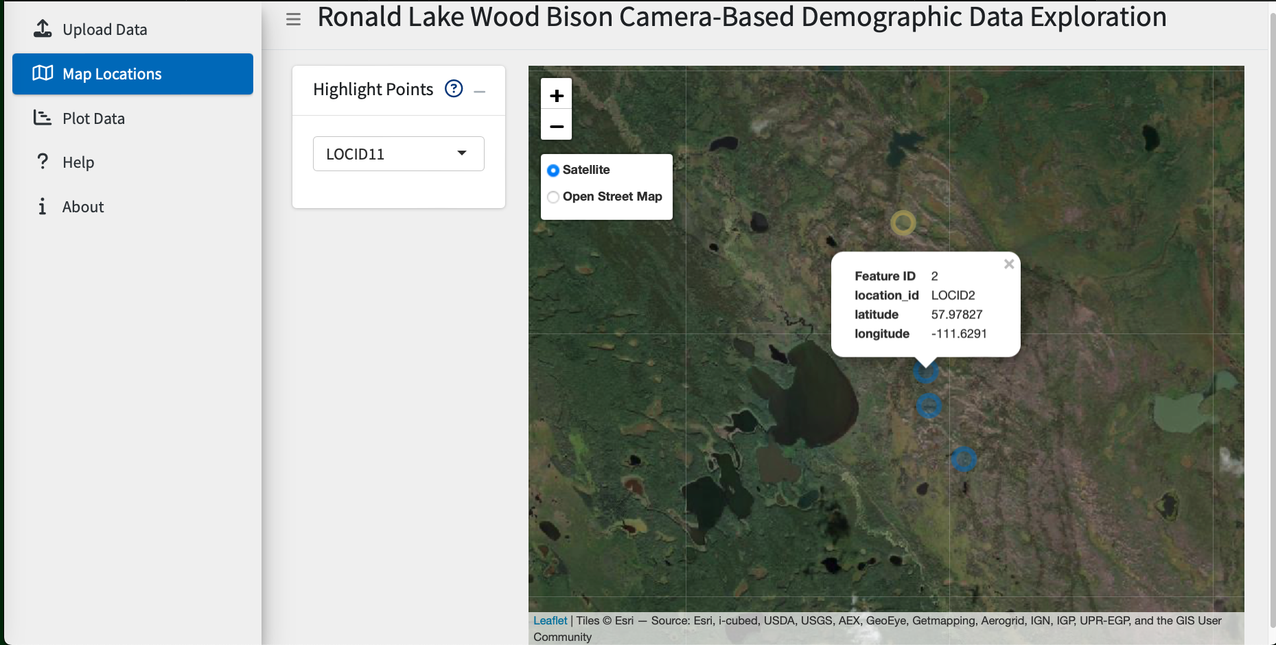
A
B
C

Slide 6
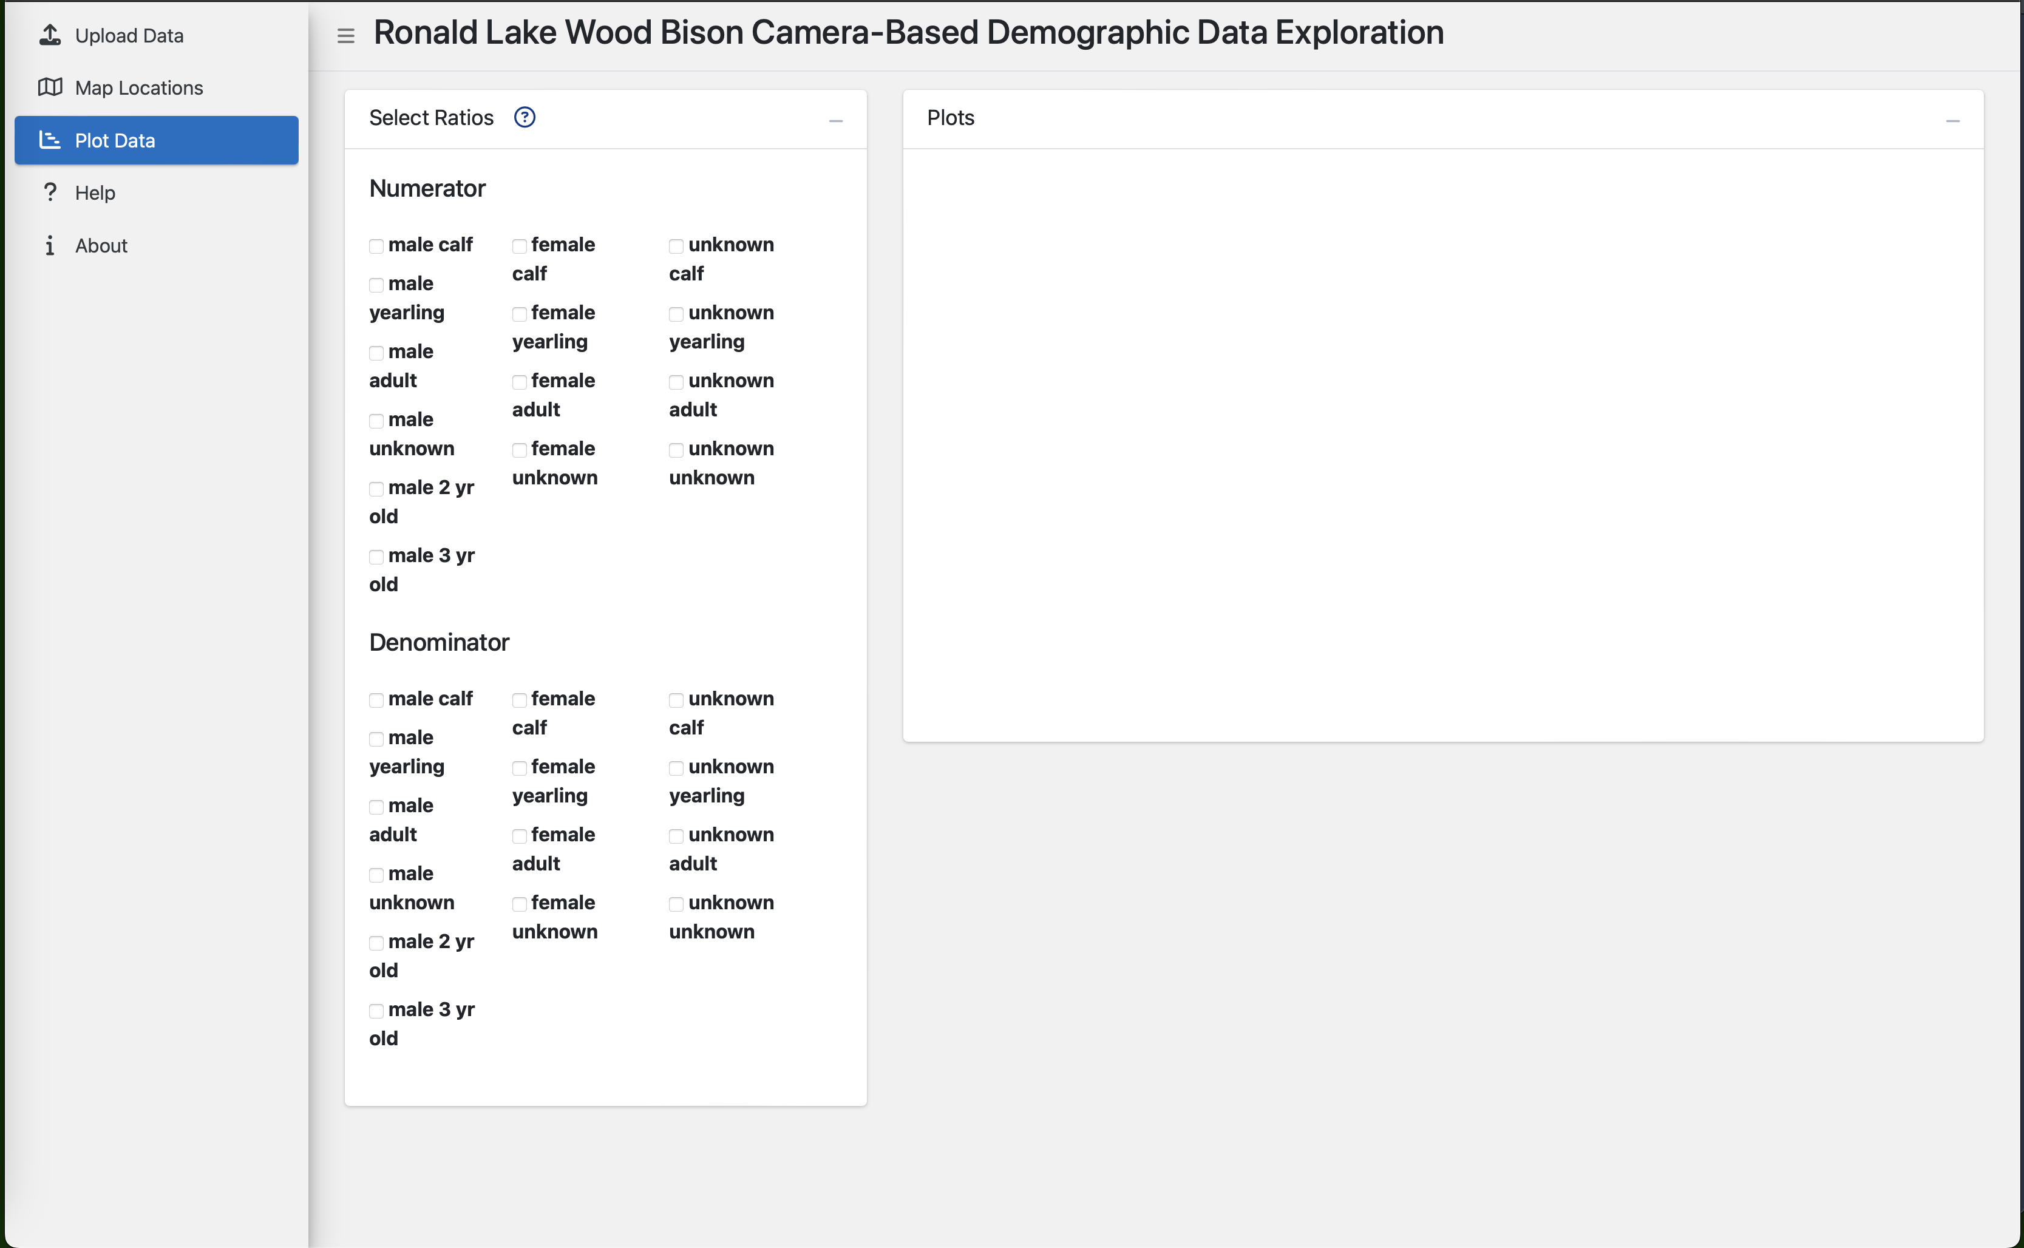
A
D
B
C

Slide 7
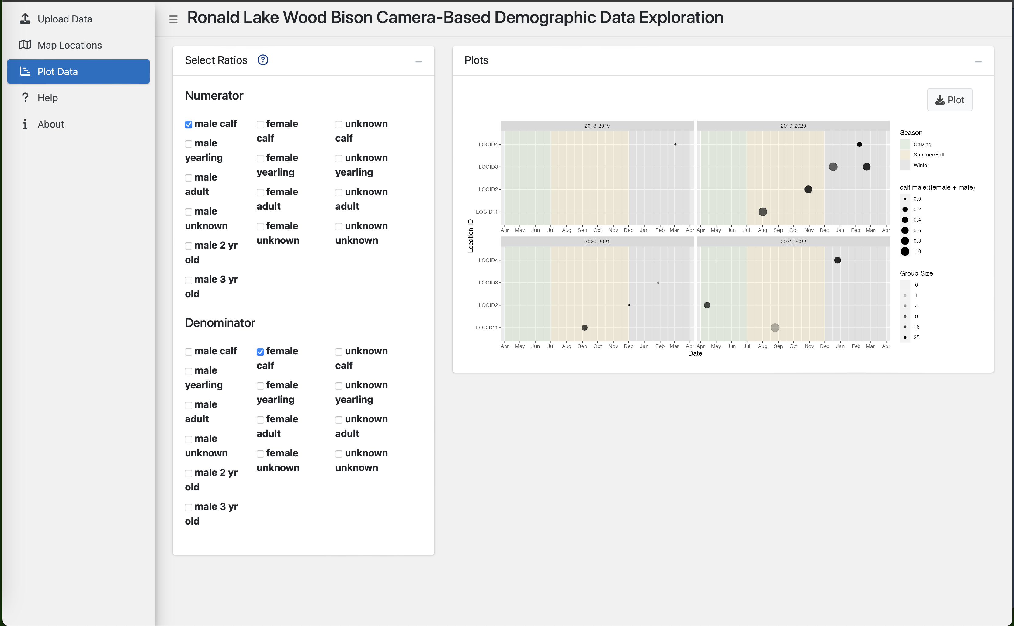
D
E

Slide 8
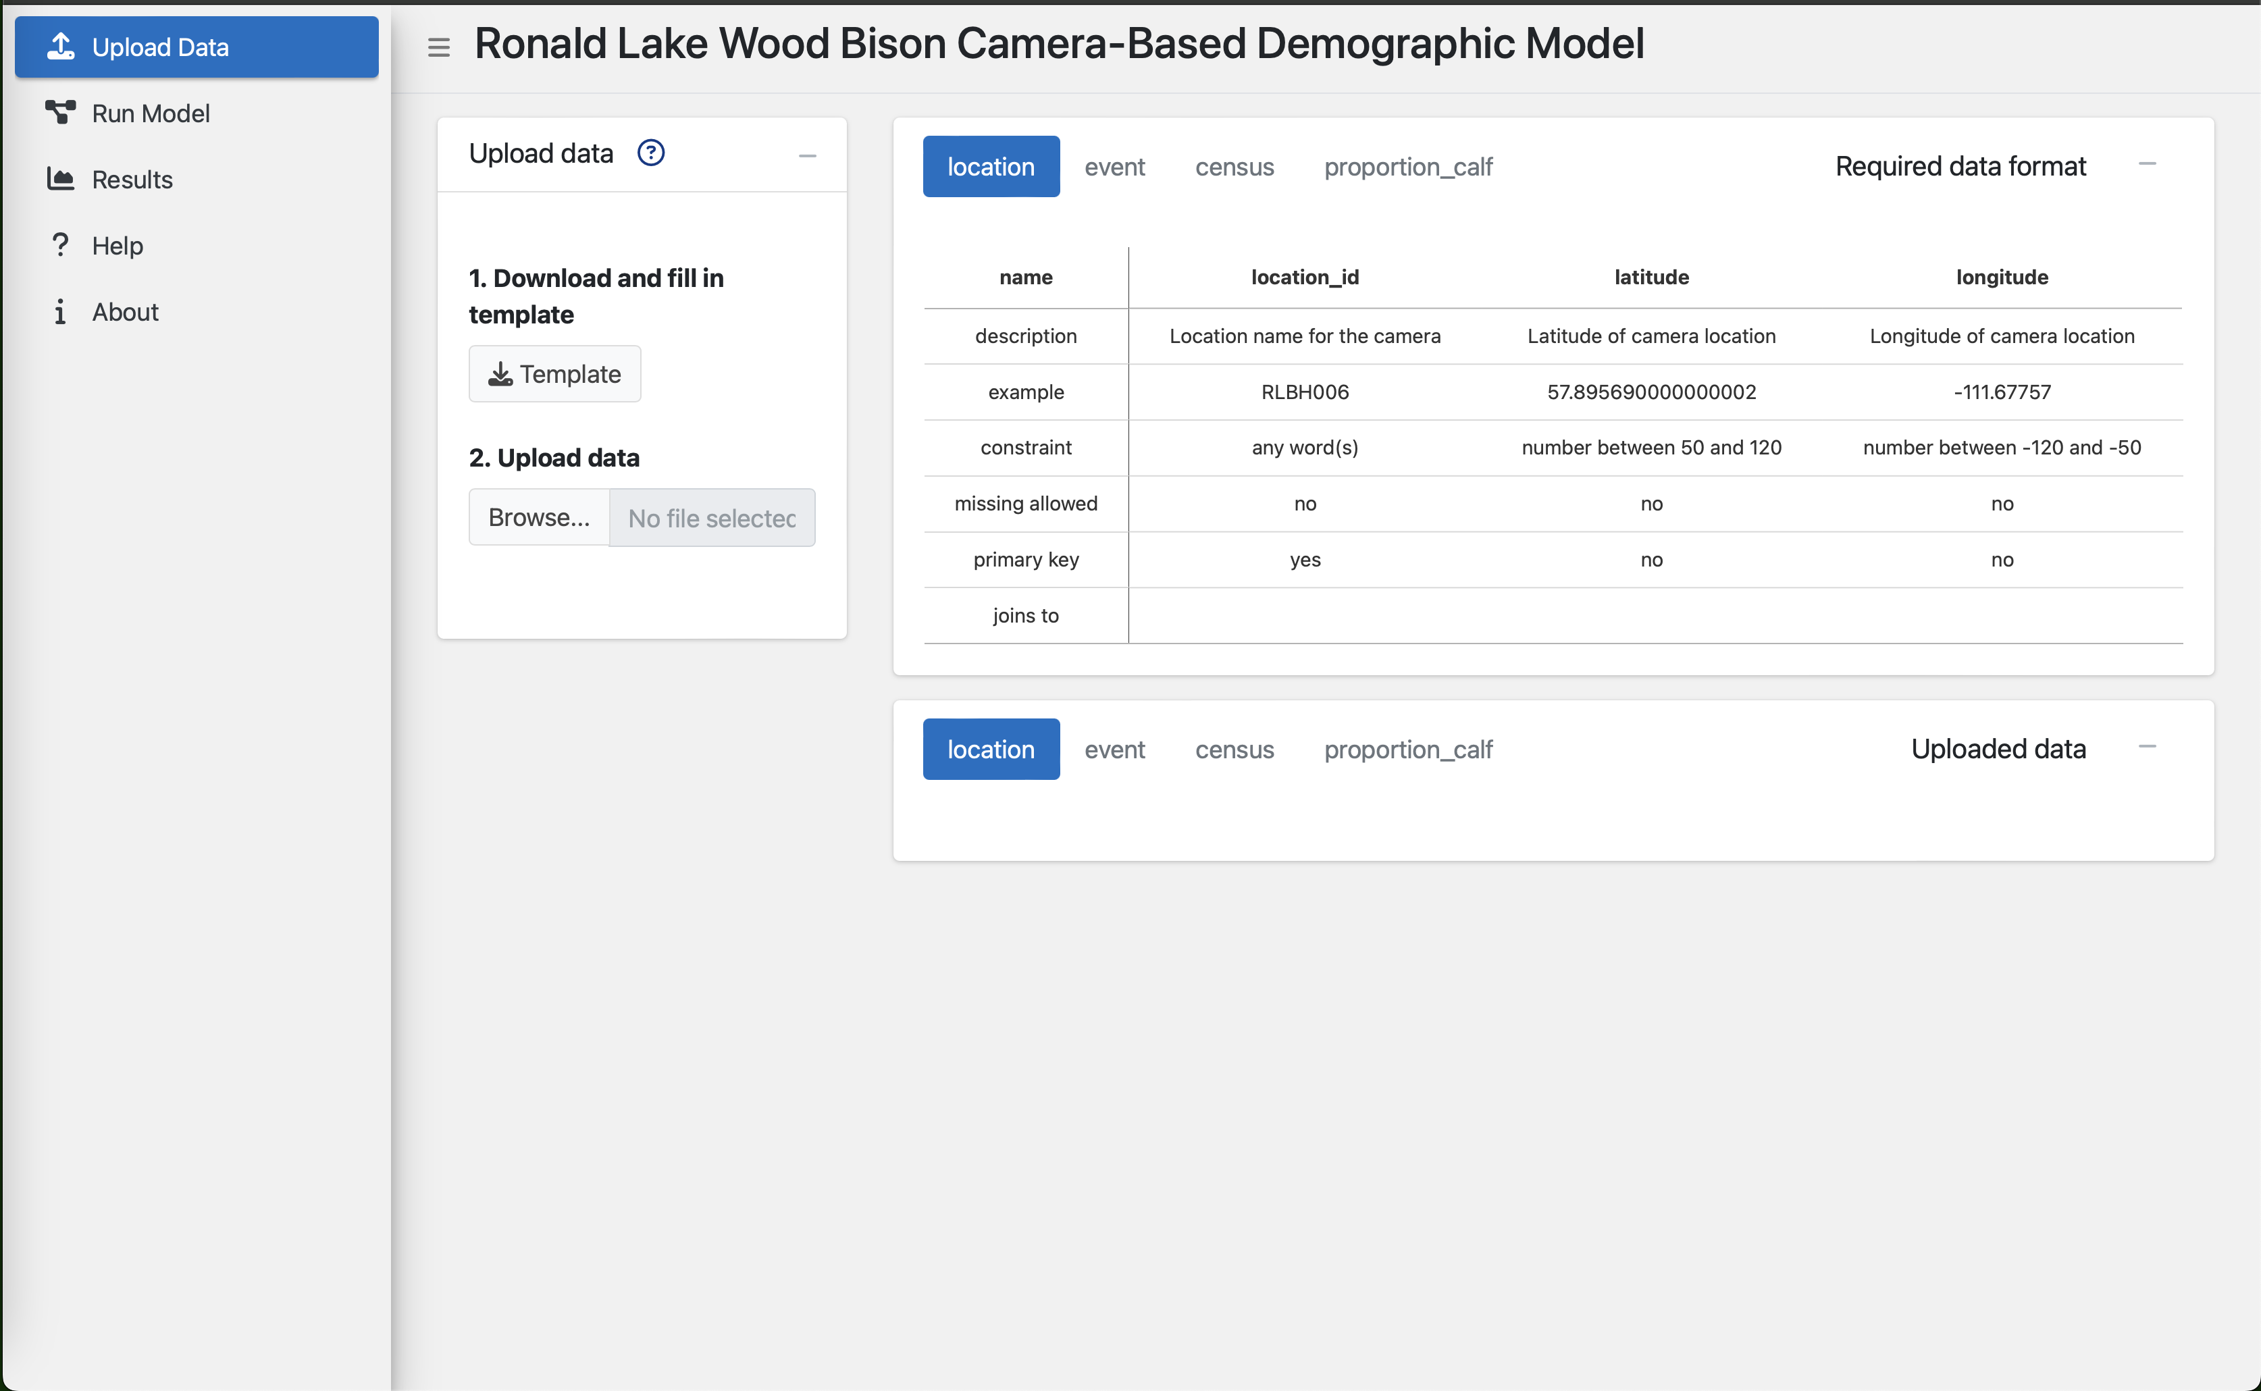
B
A
C
D

Slide 9
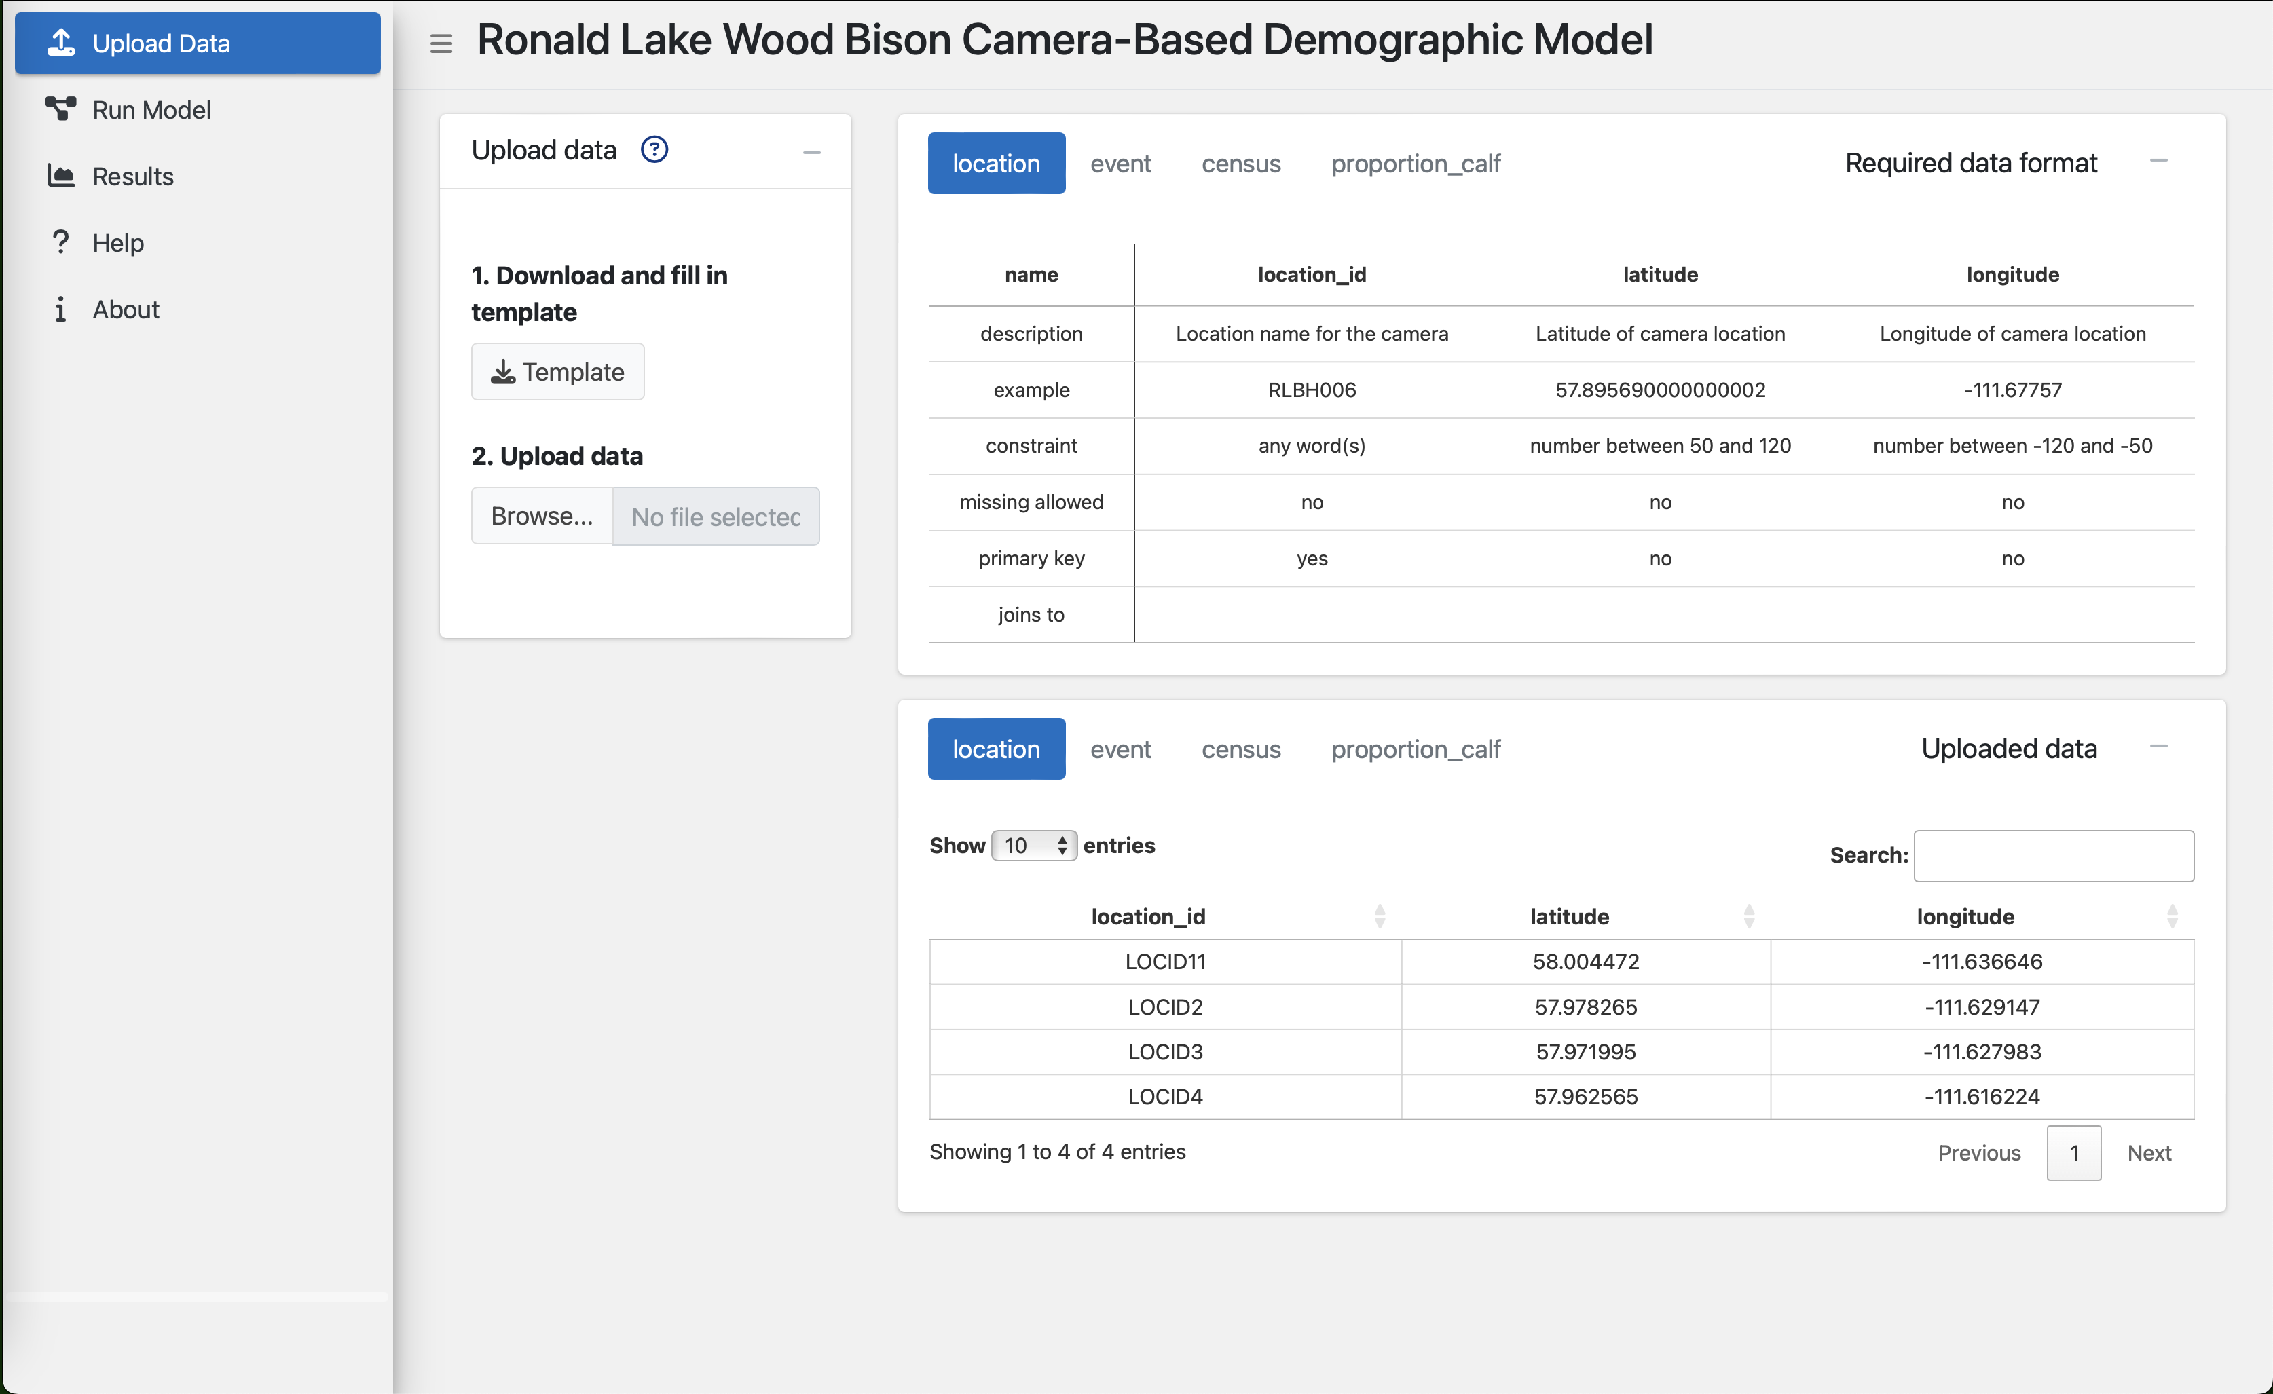
D

Slide 10
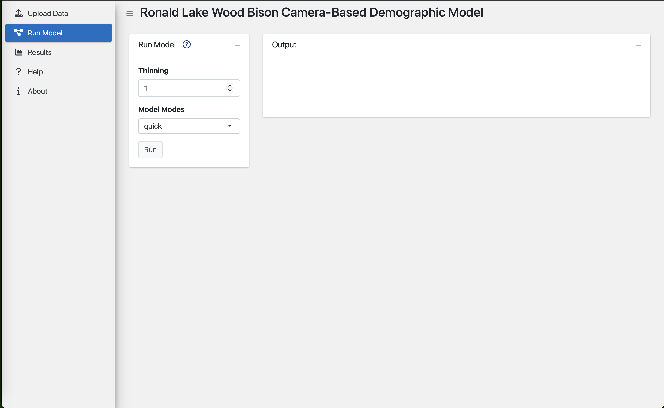
A
E
B
C
D

Slide 11
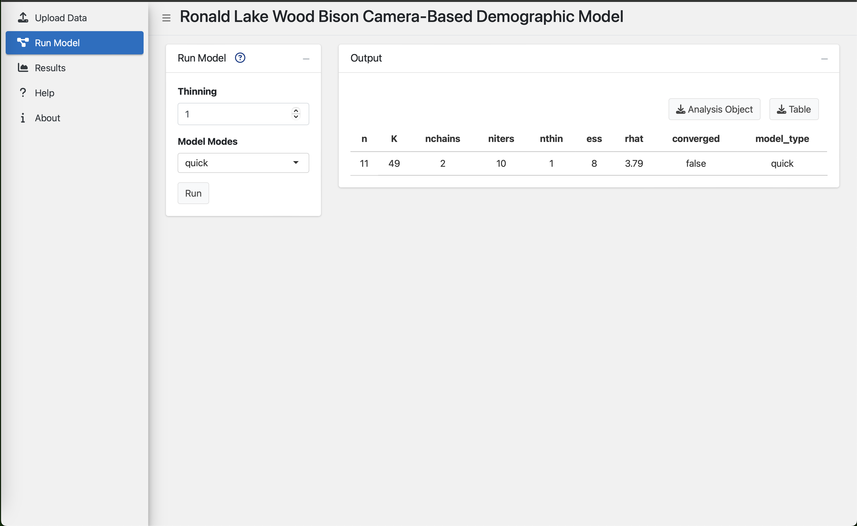
E
F
G

Slide 12
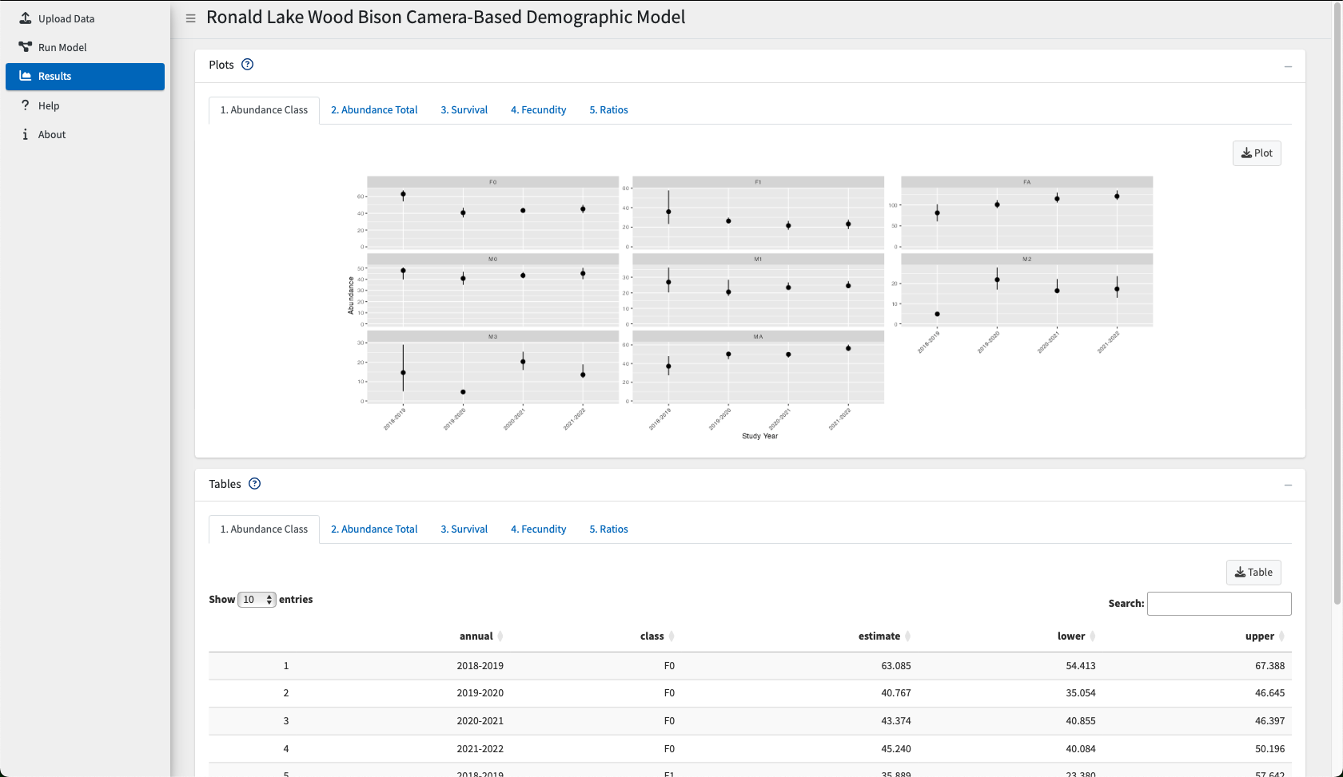
A
B
C
D
E
F
G

